Slide 1
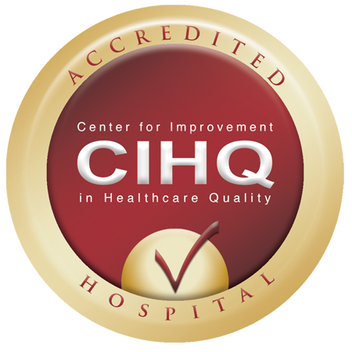
Center for Improvement in Healthcare Quality

Slide 2

About CIHQ
Formed in 1999
Headquartered in McKinney, TX
Member-based organization comprised of over 400 hospitals across the United States
Originally a small consulting firm helping hospitals with accreditation and certification compliance
Virtual company

Slide 3
Our Approval by CMS
We have been approved by CMS to deem general acute care hospitals to be in compliance with the Medicare Conditions of Participation under 42CFR.
Other accreditation programs include:
FSEC
UCC
CLHF

Slide 4

Disease Specific Certification
Certification offered in these areas:
Acute Stroke-Ready Hospital
Primary Stroke Center
Thrombectomy Capable Stroke Center
Comprehensive Stroke Center
Heart Failure
Joint Replacement Surgery
Certification assessments are woven into the initial or reaccreditation surveys
No adverse effect on accreditation status if certification is not obtained
Certifications are good for 3 years

Slide 5
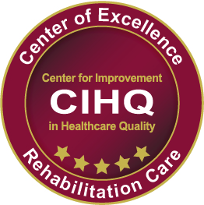
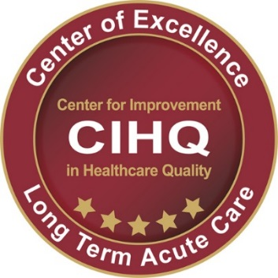
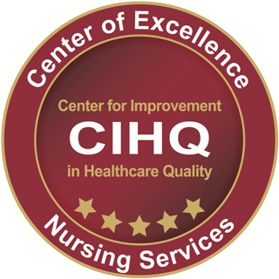

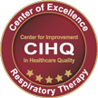
Center of Excellence Designation
Special programs designed specifically to recognize excellent care
Promulgated on evidence-based standards of care
Peer reviewed by content experts
Interwoven into the accreditation survey process

Slide 6
Approach to Medical Staff
Primary role of an accreditor is to assure compliance to the Medicare requirements
  CIHQ medical staff standards are focused on meeting the COP’
  Provides maximum latitude to the medical staff and hospital to determine governance.
Key survey activities:
  No formal interviews. Physicians are drawn in as needed
  Review of bylaws, rules, regulations, policies
  Review of credential files

Slide 7
That’s Enough
Thanks for listening.
Any Questions?
rcurtis@cihq.org

